Slide 1

Naive Bayes
Dr. Linrui Zhang
University of Central Missouri

Slide 2
The Naive Bayes
Drink | Game | Study | Fail
1 | 1 | 0 | 1
1 | 0 | 1 | 0
1 | 0 | 0 | 1
0 | 1 | 0 | 1
0 | 1 | 1 | 0
0 | 0 | 1 | 0
0 | 1 | 0 | 0
0 | 0 | 1 | 1
Will I fail the exam, if I did not drink, did not play video game and study well? (drink=0, game=0, study=1)
P(Fail=0| drink=0, game=0, study=1)
P(Fail=1| drink=0, game=0, study=1)

Slide 3
Conditional Probability
In probability theory, conditional probability is a measure of the probability of an event occurring, given that another event (by assumption, presumption, assertion or evidence) has already occurred.
P(A|B) – “the conditional probability of A given B” or “the probability of A under the condition B”

Slide 4
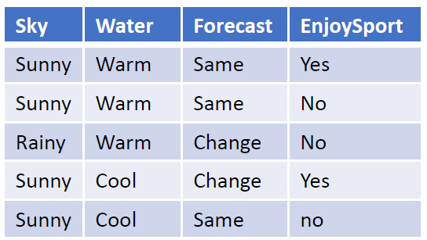
Conditional Probability
P(yes) = 2/5
P(Sunny| yes) = 2/2
P(Warm| yes) = 1/2
P(change | yes) = 1/2
P(no) = ?
P(Sunny | no) = ?
P(Warm | no) = ?
P(Change | no) = ?

Slide 5
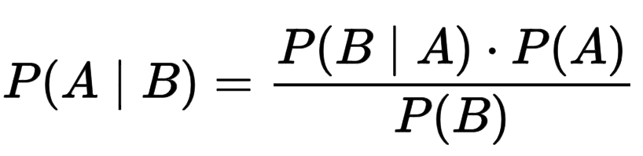
Bayes’ Theorem
Axiom of probability
P(A ∩ B) = P (A | B) P(B)
Bayes’ Theorem

Slide 6
The Naive Bayes Assumption
P(x₁, x₂, … , x_{n} | y) = P(x₁|y) P(x₂|y) … P(x_{n}|y)
P(Sunny, Warm, Same|Y)
P(Sunny|Y)P(Warm|Y)P(Same|Y)
Why do we need to make naïve Bayes assumption?
P(Sunny, Cool, Same|Y)
P(Sunny|Y)P(Cool|Y)P(Same|Y)

Slide 7
Naïve Bayes
It’s time to take notes!
Drink | Game | Study | Fail
1 | 1 | 0 | 1
0 | 0 | 1 | 0
1 | 0 | 1 | 0
1 | 0 | 0 | 1
0 | 1 | 0 | 1
0 | 1 | 1 | 0
0 | 1 | 0 | 0
0 | 0 | 1 | 1

Slide 8
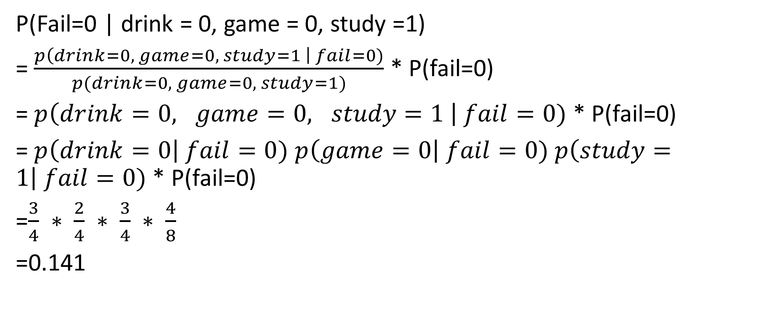
Naïve Bayes
P(Fail=0 | drink = 0, game = 0, study =1)
= $\frac{p\left(drink=0, game=0, study=1 \right| fail=0)}{p(drink=0, game=0, study=1)}$ * P(fail=0)
= $p\left(drink=0, game=0, study=1 \right| fail=0)$ * P(fail=0)
= $p\left(drink=0\right| fail=0)$ $p\left(game=0\right| fail=0)$ $p\left(study=1\right| fail=0)$ * P(fail=0)
=$\frac{3}{4} ∗ \frac{2}{4} ∗ \frac{3}{4} ∗ \frac{4}{8}$
=0.141

Slide 9
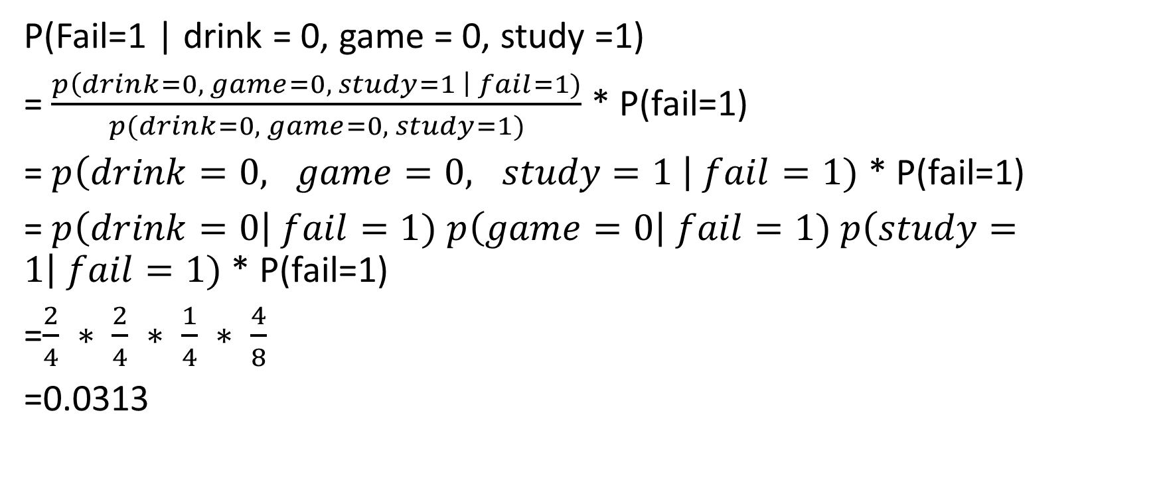
Naïve Bayes
P(Fail=1 | drink = 0, game = 0, study =1)
= $\frac{p\left(drink=0, game=0, study=1 \right| fail=1)}{p(drink=0, game=0, study=1)}$ * P(fail=1)
= $p\left(drink=0, game=0, study=1 \right| fail=1)$ * P(fail=1)
= $p\left(drink=0\right| fail=1)$ $p\left(game=0\right| fail=1)$ $p\left(study=1\right| fail=1)$ * P(fail=1)
=$\frac{2}{4} ∗ \frac{2}{4} ∗ \frac{1}{4} ∗ \frac{4}{8}$
=0.0313

Slide 10
Naïve Bayes
P(Fail=0 | drink = 0, game = 0, study =1) > P(Fail=0 | drink = 0, game = 0, study =0)
Not Fail

Slide 11
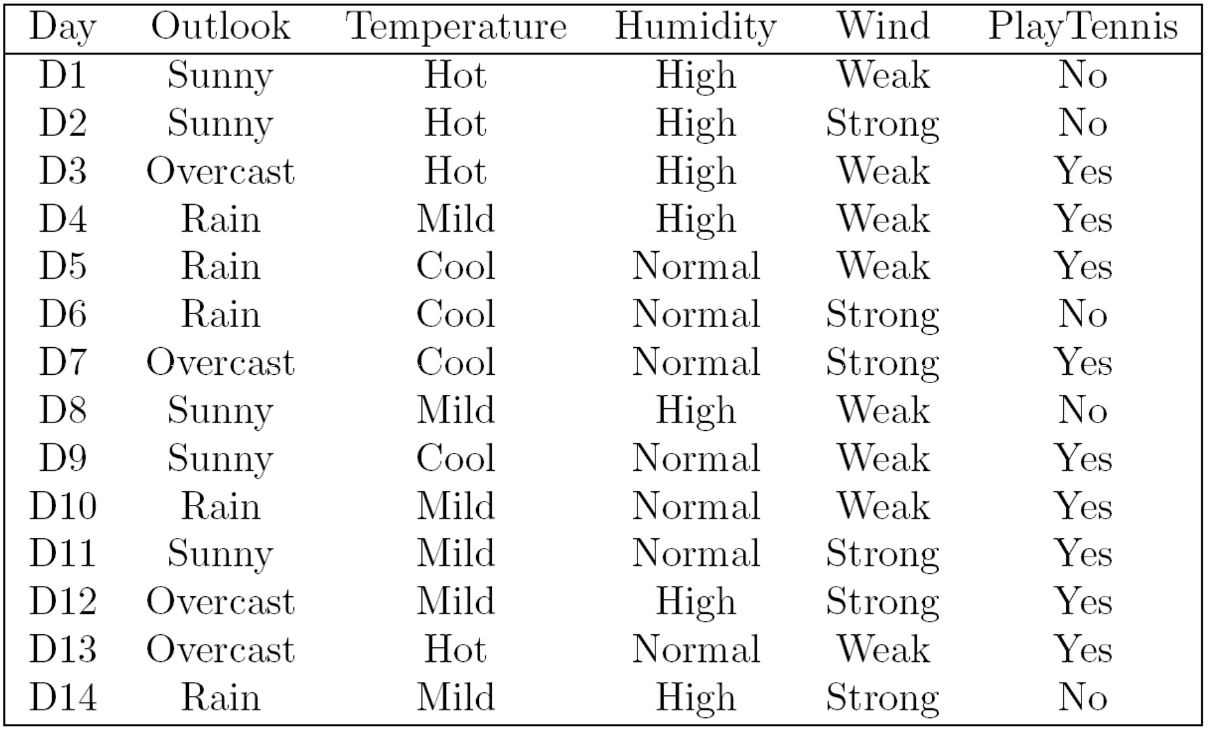
Example 1

Slide 12
When do I play tennis?
Will I play tennis?
Given:
Outlook --Sunny
Temperature -- Cool
Humidity -- High
Wind -- Strong

Slide 13
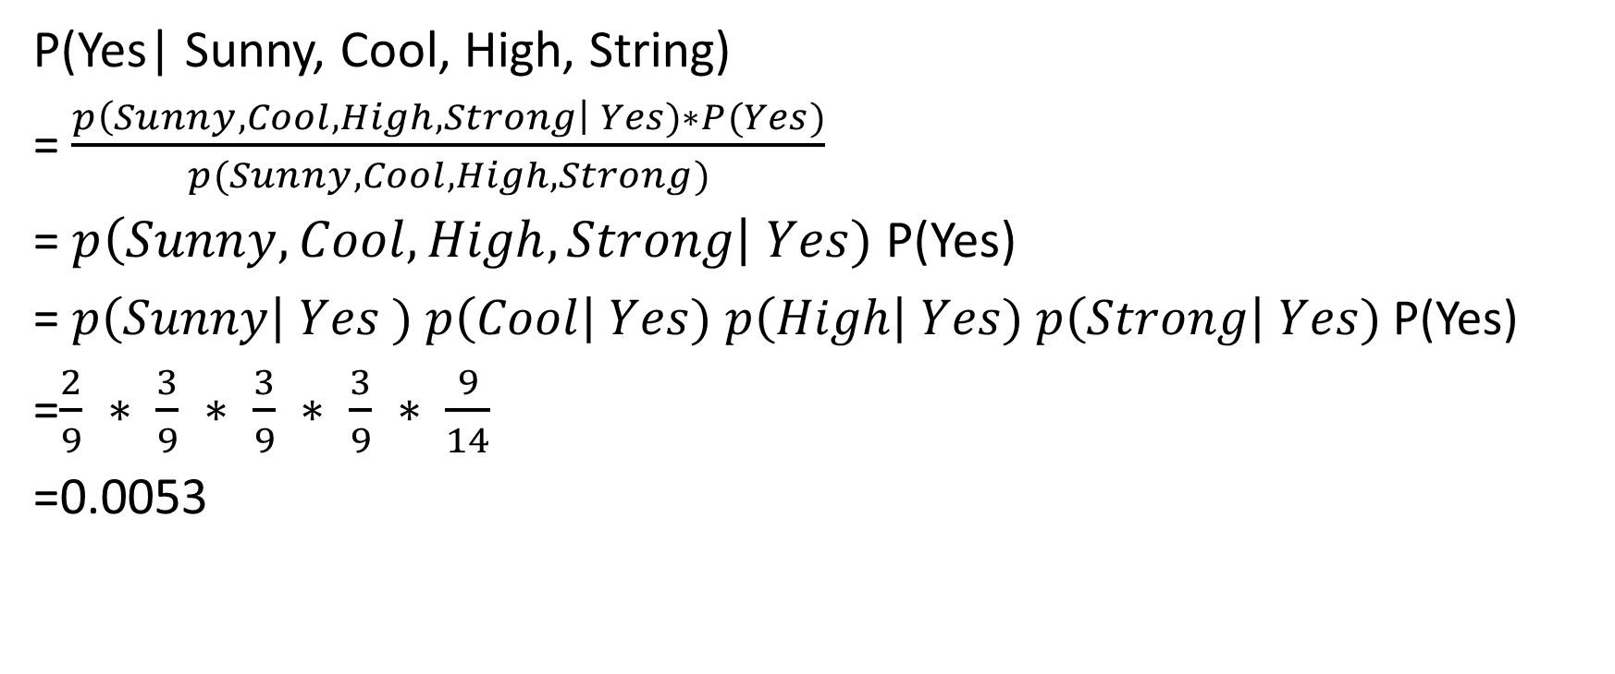
Example 1
P(Yes| Sunny, Cool, High, String)
= $\frac{p\left(Sunny, Cool, High, Strong\right| Yes)∗P(Yes)}{p(Sunny, Cool, High, Strong)}$
= $p\left(Sunny, Cool, High, Strong\right| Yes)$ P(Yes)
= $p\left(Sunny\right| Yes )$ $p\left(Cool\right| Yes)$ $p\left(High\right| Yes)$ $p\left(Strong\right| Yes)$ P(Yes)
=$\frac{2}{9} ∗ \frac{3}{9} ∗ \frac{3}{9} ∗ \frac{3}{9} ∗ \frac{9}{14}$
=0.0053

Slide 14
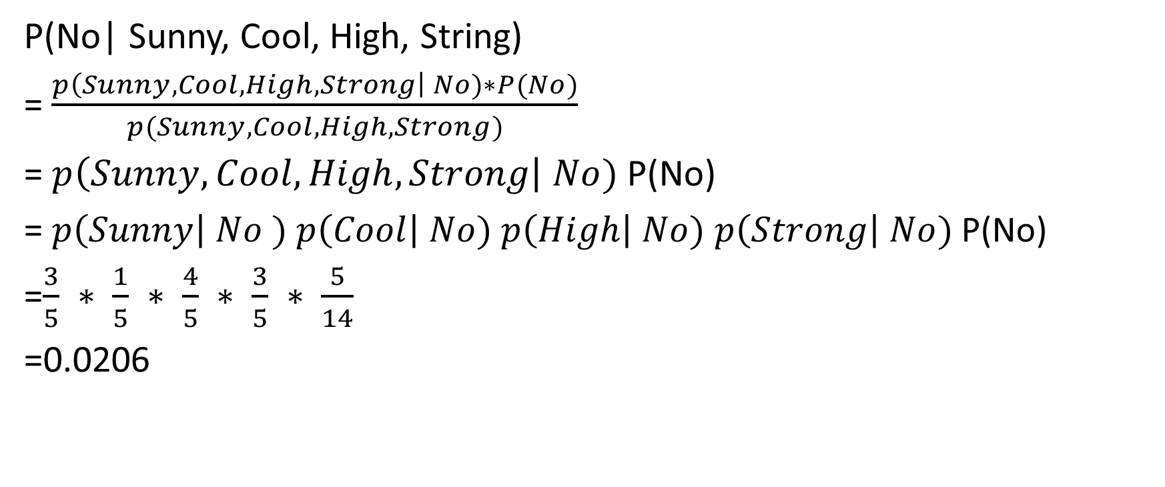
Example 1
P(No| Sunny, Cool, High, String)
= $\frac{p\left(Sunny, Cool, High, Strong\right| No)∗P(No)}{p(Sunny, Cool, High, Strong)}$
= $p\left(Sunny, Cool, High, Strong\right| No)$ P(No)
= $p\left(Sunny\right| No )$ $p\left(Cool\right| No)$ $p\left(High\right| No)$ $p\left(Strong\right| No)$ P(No)
=$\frac{3}{5} ∗ \frac{1}{5} ∗ \frac{4}{5} ∗ \frac{3}{5} ∗ \frac{5}{14}$
=0.0206

Slide 15
Example 1
P(Yes| Sunny, Cool, High, String) < P(No| Sunny, Cool, High, String)
Not Play Tennis

Slide 16
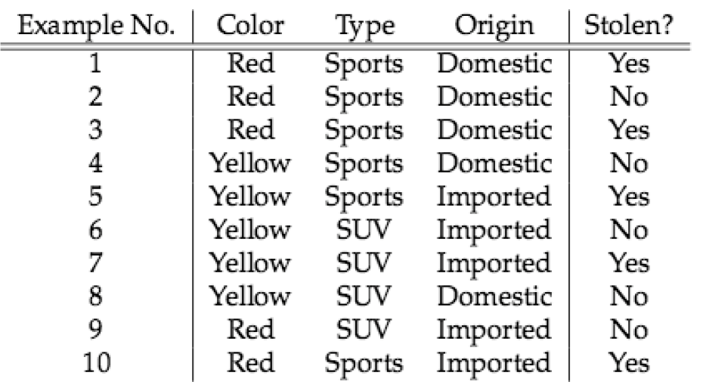
Example 2
Given the following car theft training examples, construct a Naïve Bayes classifier:
Given that a car is a red, SUV and of domestic origin, is it more likely to be stolen than not?

Slide 17
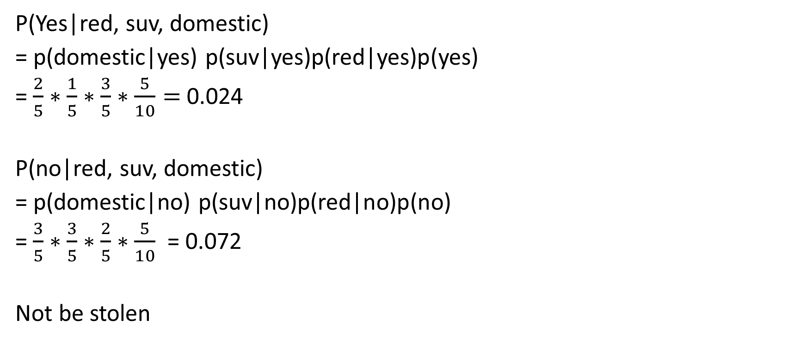
Example 2
P(Yes|red, suv, domestic)
= p(domestic|yes) p(suv|yes)p(red|yes)p(yes)
= $\frac{2}{5}∗\frac{1}{5}∗\frac{3}{5}∗\frac{5}{10}=$0.024
P(no|red, suv, domestic)
= p(domestic|no) p(suv|no)p(red|no)p(no)
= $\frac{3}{5}∗\frac{3}{5}∗\frac{2}{5}∗\frac{5}{10}$ = 0.072
Not be stolen

Slide 18
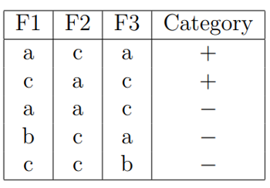
QUIZ TIME
Imagine that you are given the following set of training examples. Each feature can take on one of three nominal values: a, b, or c.
How would a Naïve Bayes system classify the following test example? Be sure to show your work.
F1 = a, F2 = c, F3 = b

Slide 19
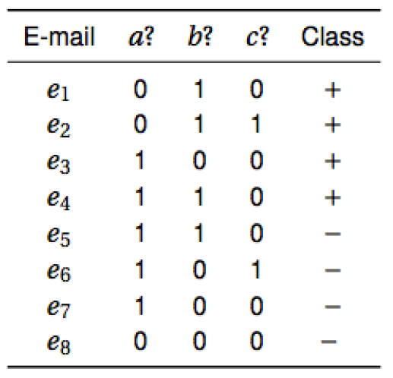
Homework
Email Classification: Training Data
+ denotes spam
Denotes not spam
If you receive an email with feature set (a=1, b=1, c=1), which class is it like to be (spam or not spam)?

